Slide 1
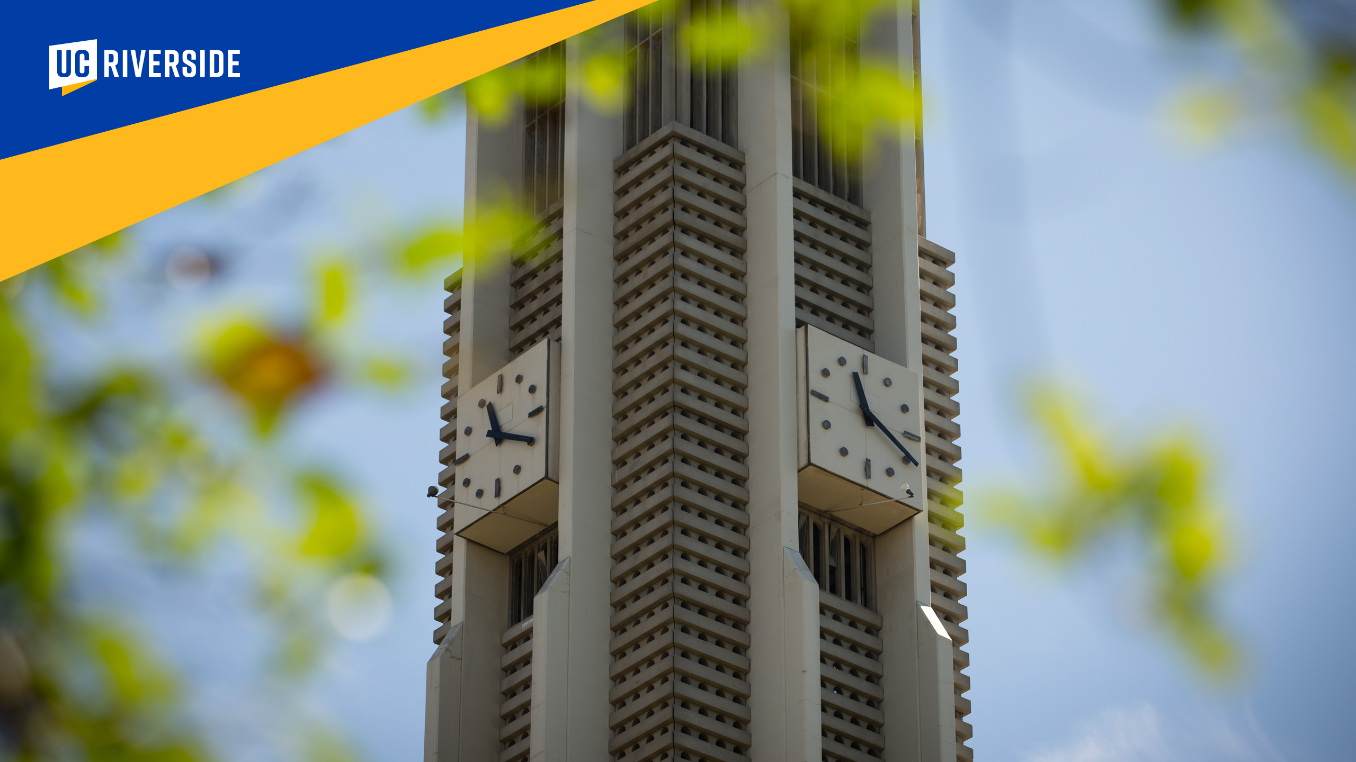

Dissertation and Thesis Formatting and Submission Workshop
Amanda Wong
Trina Elerts
Jessica Renteria
Graduate Academic Affairs
951-827-3315
GAA@ucr.edu
Graduate Academic Affairs

Slide 2
Dissertation and Thesis Formatting and Submission Workshop
Amanda Wong
Trina Elerts
Jessica Renteria
951-827-3315
GAA@ucr.edu
Graduate Academic Affairs

Slide 3
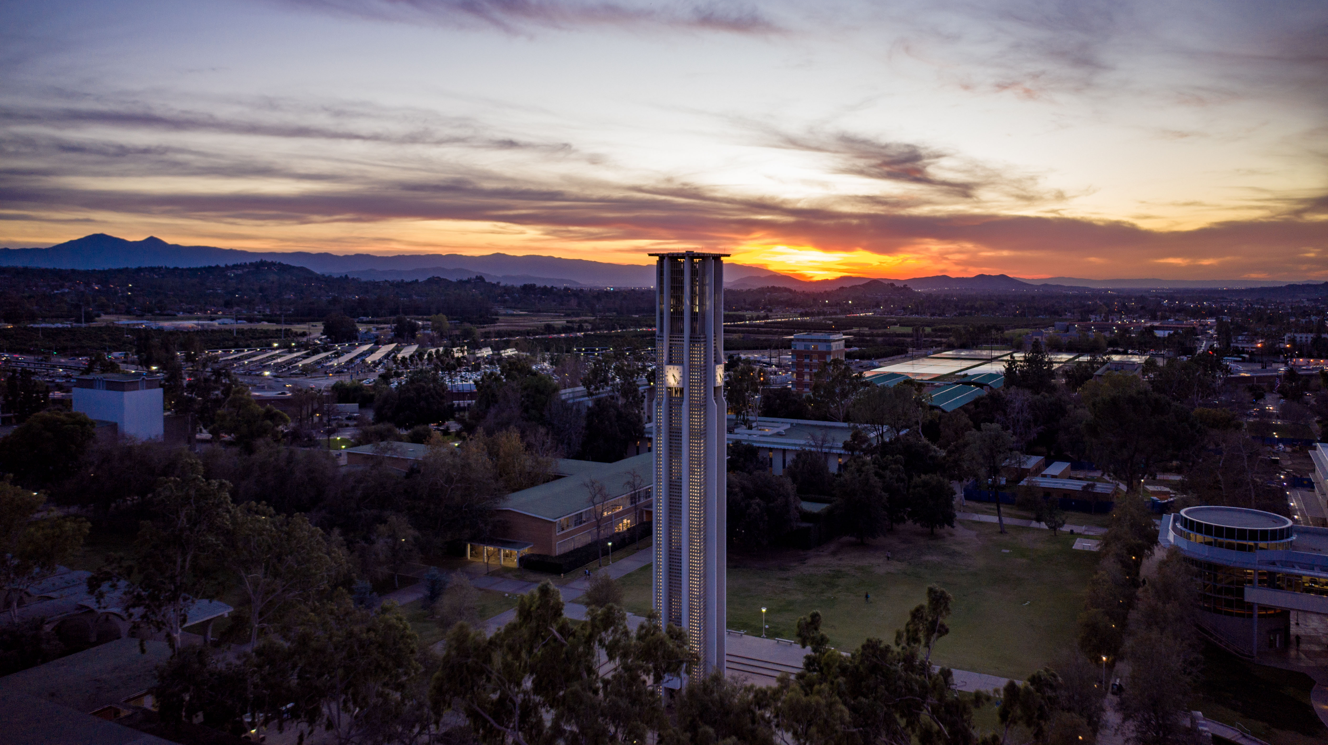

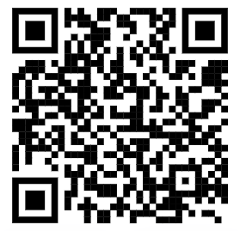
The purpose of this workshop is to provide information about formatting the document and the steps involved in submission and graduation.
Graduate Academic Affairs, Graduate Division
    Amanda.Wong@ucr.edu (A-H)
    Trina.Elerts@ucr.edu (I-P)
    Jessica.Renteria@ucr.edu (Q-Z)
    University Office Building, 951-827-3315
    GAA is open M-Th 8am-Noon, 1pm-5pm
    On Fridays, all Graduate Division staff work remotely
    https://graduate.ucr.edu/

Slide 4
General Resources
Grad Success - https://graduate.ucr.edu/gradsuccess
  Graduate Writing Center
  By-request Programming
  Graduate Writer’s Room
  Workshops
Counseling & Psychological Services - https://counseling.ucr.edu/ *
  Grad Wellness Circles (with GSA)
  Every Third Thursday 6:30-8pm
  Meeting ID: 922 7738 8205
  Passcode: 816554
  *visit Graduate Student Resources page on the CAPS web site for more resources
Graduate Student Association (GSA) - https://gsa.ucr.edu/
  Travel Grants GSHIP information
  Basic Needs information Departmental Resources
  Diversity and Inclusion

Slide 5
Document Style
FIRST RULE: Format must conform to the Graduate Division requirements
  Download the Format Guide - https://graduate.ucr.edu/filing-resources#format-guide
Style is at the discretion of your committee
  You may choose to use MLA or APA or another style manual as a guide but be careful. These guides do not always match the Graduate Division requirements.
Journal format or Scientific format
  Each chapter is a separate paper
  Must have a general introduction and conclusion
  Be consistent! Must use the same style for each chapter (including the abstract, bibliography and footnotes/endnotes)

Slide 6

Format – Preliminary Pages
Title Page (page i, not printed)
Copyright Page (page ii, not printed)
Signature Approval Page (page iii, not printed)
Acknowledgements (optional)
Dedication (optional)
Abstract (required for PhD only)
Table of Contents (required)
List of Figures, Tables, Abbreviations, Symbols, etc. (required, if necessary)
Preface or Forward (optional)

Slide 7
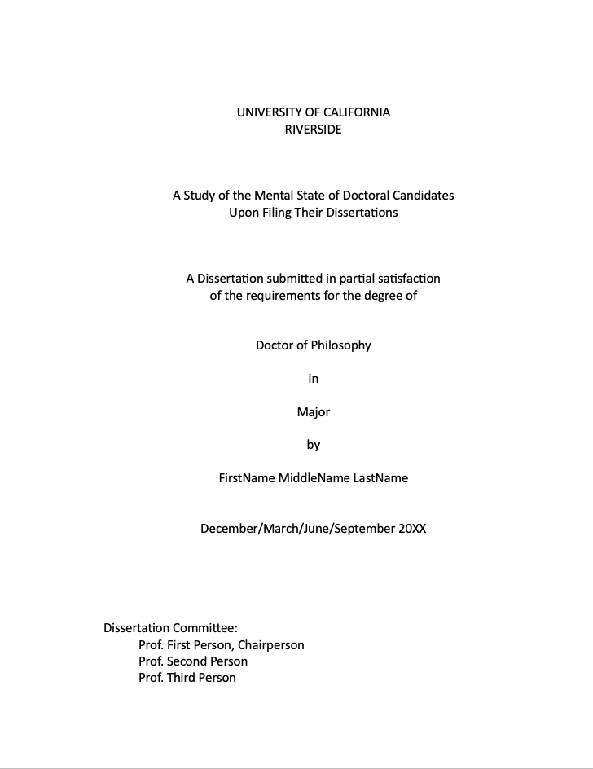
TITLE PAGE

Slide 8

COPYRIGHT
PAGE

Slide 9
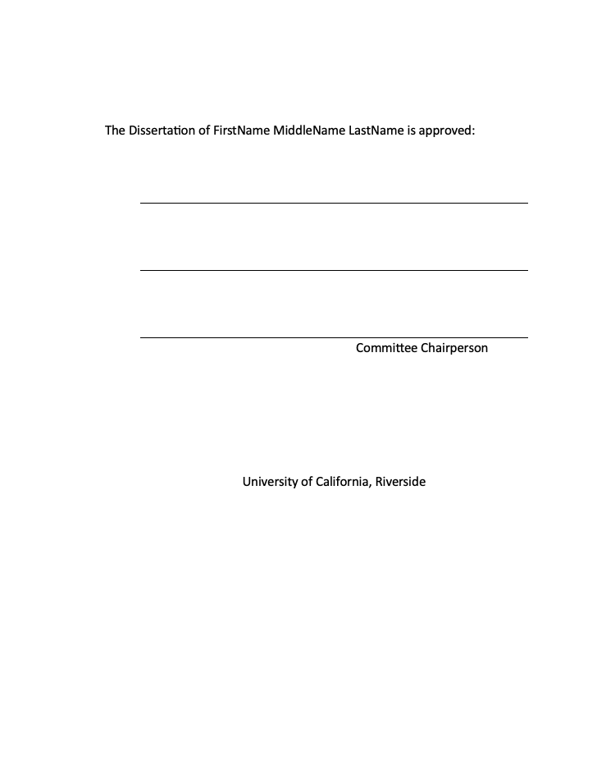
SIGNATURE APPROVAL PAGE

Slide 10
Format – Preliminary Pages
Title Page (page i, not printed)
Copyright Page (page ii, not printed)
Signature Approval Page (page iii, not printed)
Acknowledgements (optional)
Dedication (optional)
Abstract (required for PhD only)
Table of Contents (required)
List of Figures, Tables, Abbreviations, Symbols, etc. (required, if necessary)
Preface or Forward (optional)

Slide 11
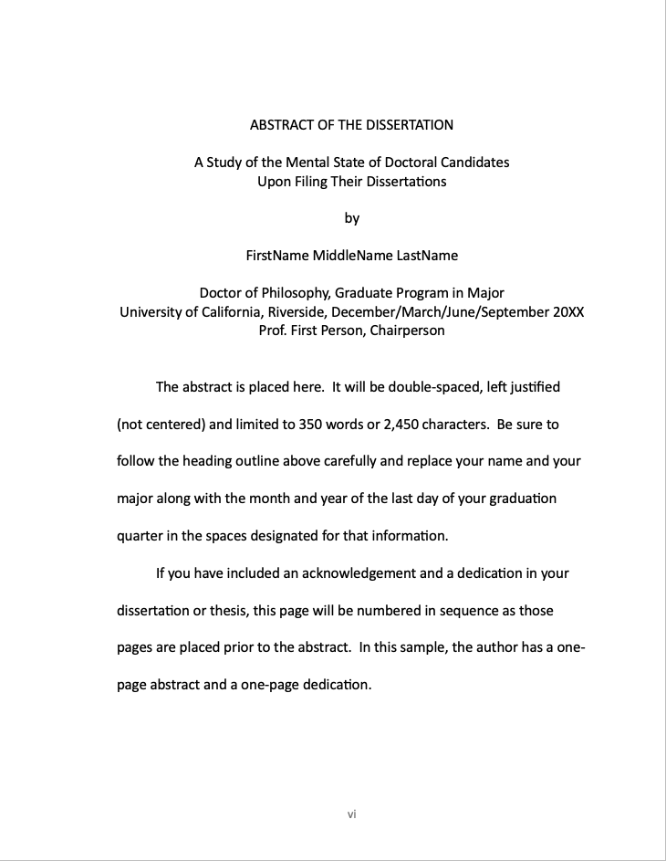
ABSTRACT

Slide 12
Format – Preliminary Pages
Title Page (page i, not printed)
Copyright Page (page ii, not printed)
Signature Approval Page (page iii, not printed)
Acknowledgements (optional)
Dedication (optional)
Abstract (required for PhD only)
Table of Contents (required)
List of Figures, Tables, Abbreviations, Symbols, etc. (required, if necessary)
Preface or Forward (optional)

Slide 13
Format – Document Body
Pagination - 3 separate sections
  no numbers
  lowercase Roman numerals
  regular numbers
Margins
  1.5 inches top and left
  1 inch bottom and right
Widows and Orphans*
  remove these *examples on following slides
Tables, Figures ,and Captions
Double Spacing
  General rule, with some exceptions
Type Size
  10, 11 or 12 point font
Font Style
  Any legible style is fine
Use of Color is Acceptable

Slide 14
Widow Line
one line at the top of the page

Slide 15
Avoid a Widow
by placing two lines of text
at the top of the page

Slide 16
Orphan
Heading

Slide 17
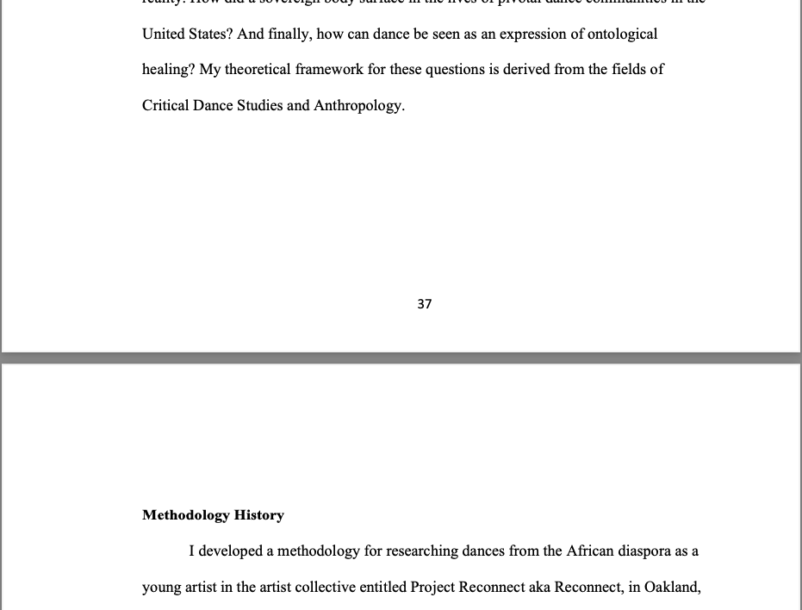
Avoid an Orphan
Heading
by adding extra space at the bottom of the page

Slide 18
Format – Document Body
Pagination - 3 separate sections
  no numbers
  lowercase Roman numerals
  regular numbers
Margins
  1.5 inches top and left
  1 inch bottom and right
Widows and Orphans
  remove these
Tables, Figures ,and Captions
Double Spacing
  General rule, with some exceptions
Type Size
  10, 11 or 12 point font
Font Style
  Any legible style is fine
Use of Color is Acceptable

Slide 19
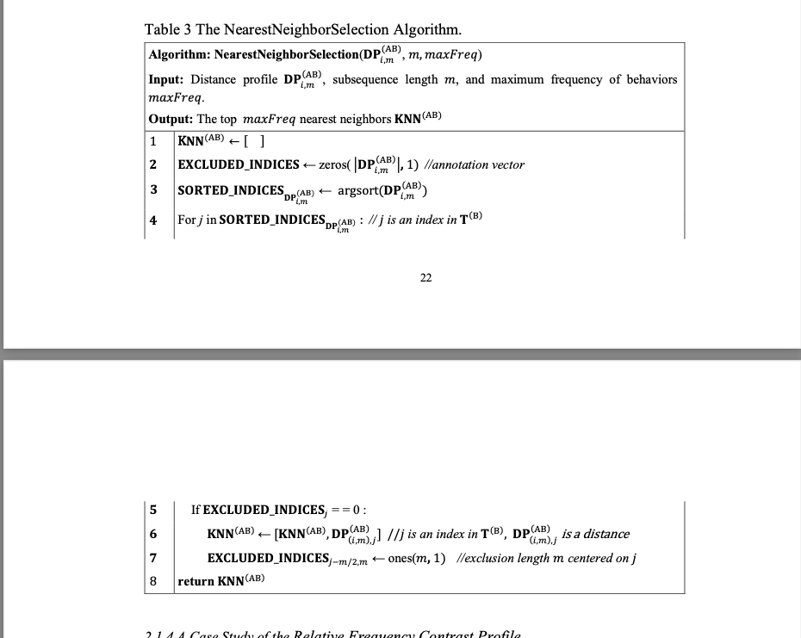
Do not Split
Tables or Figures across pages

Slide 20
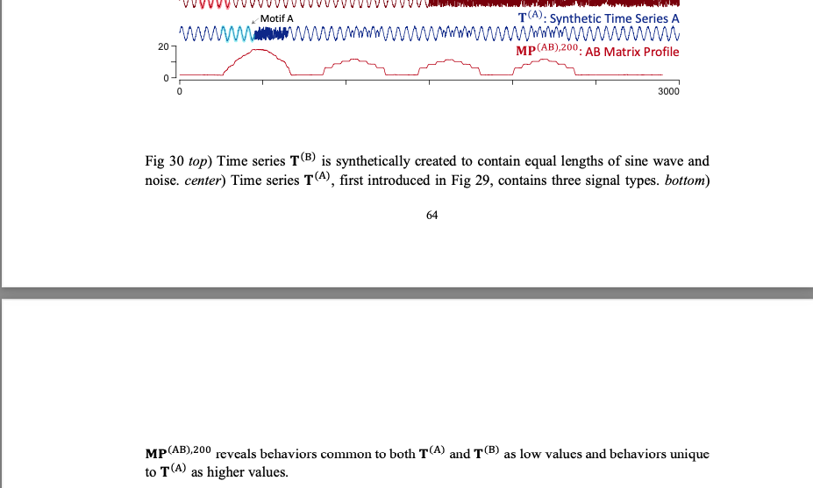
Do not separate
the caption from the figure

Slide 21
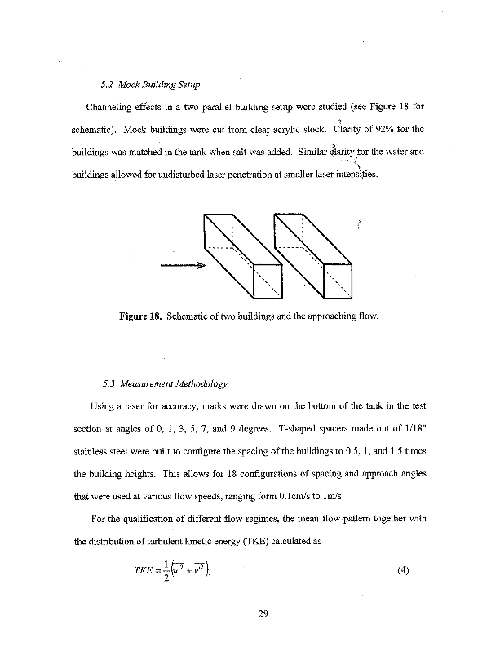
Figure and Caption embedded correctly in the text

Slide 22
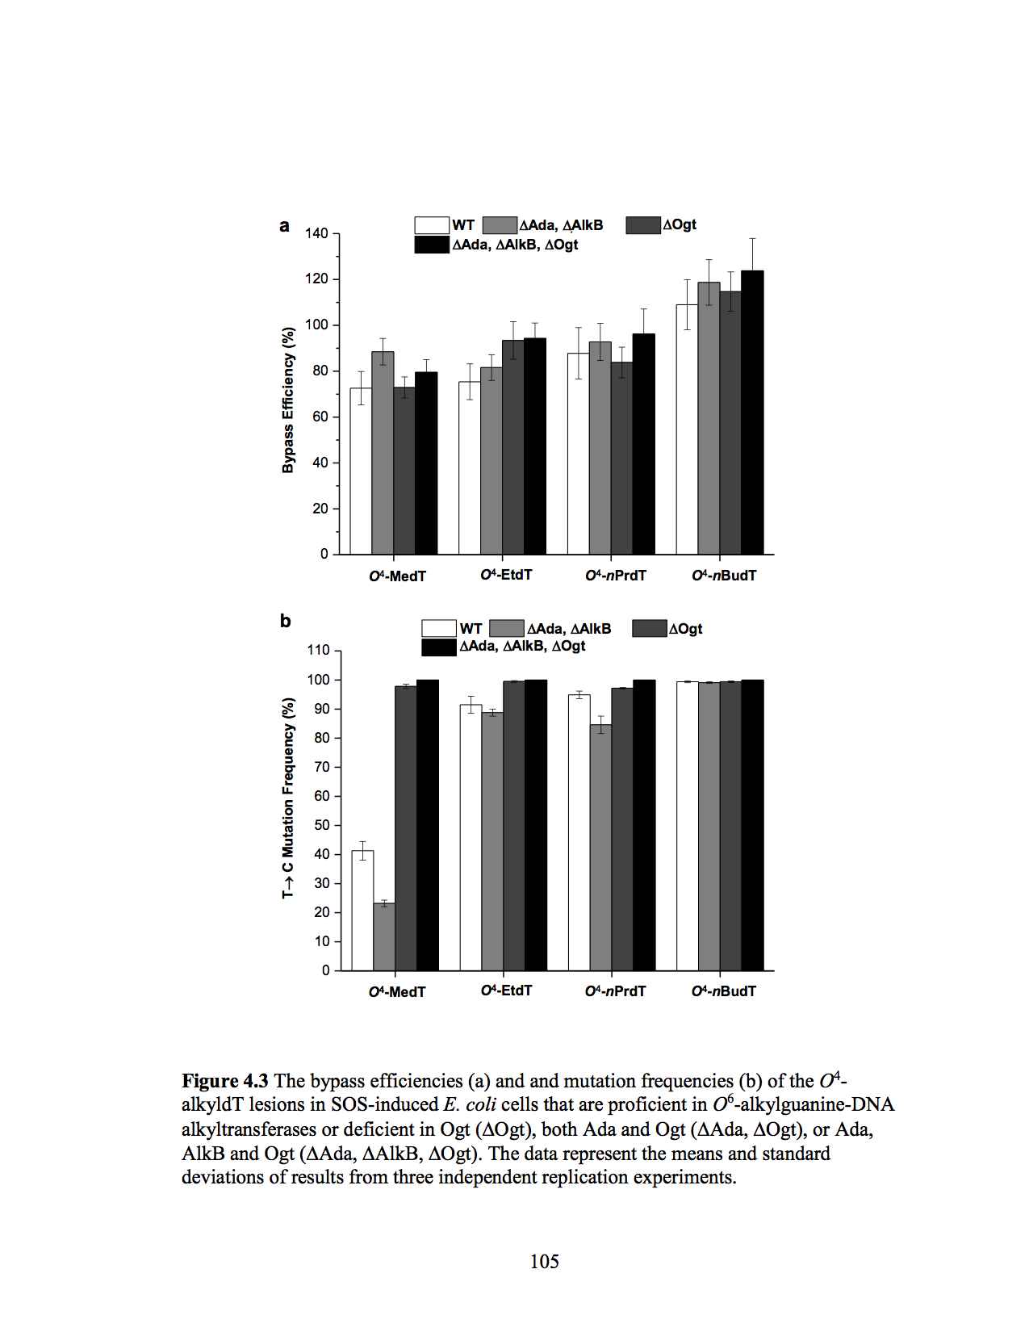
Figure and Caption on page without text

Slide 23

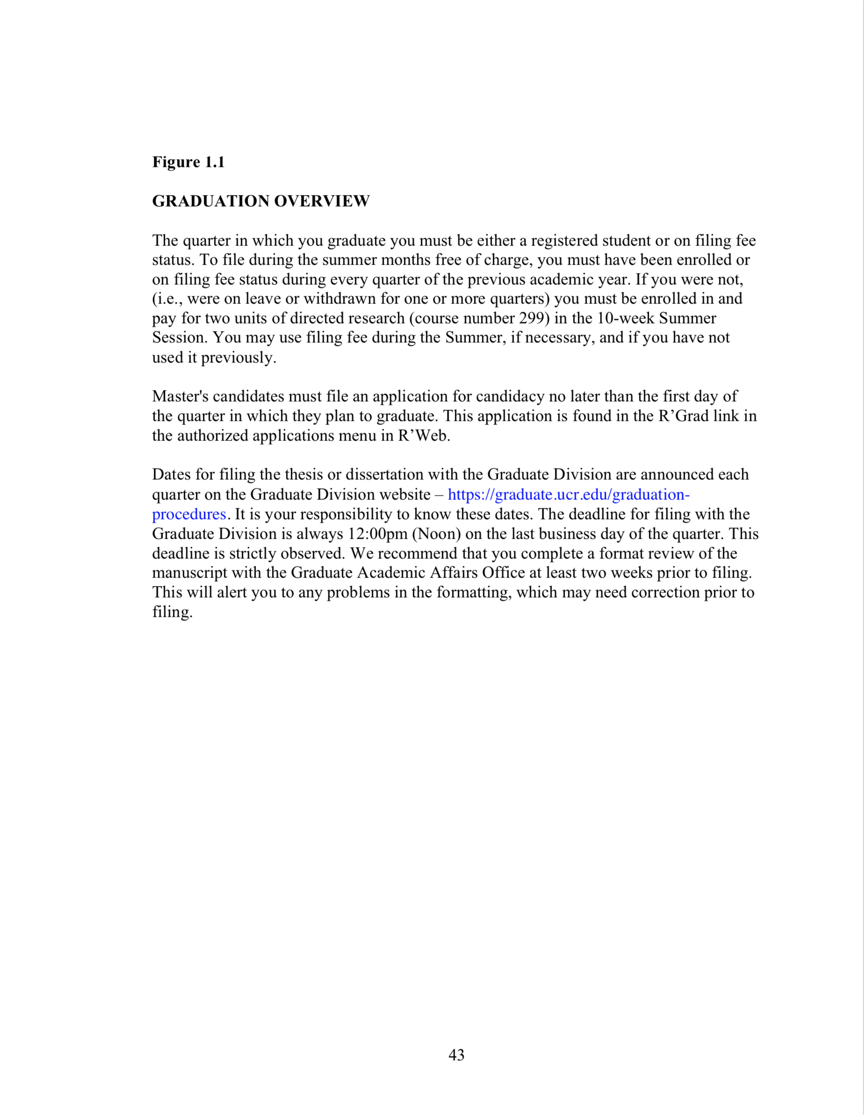
Figure and Caption on Separate Pages

Slide 24
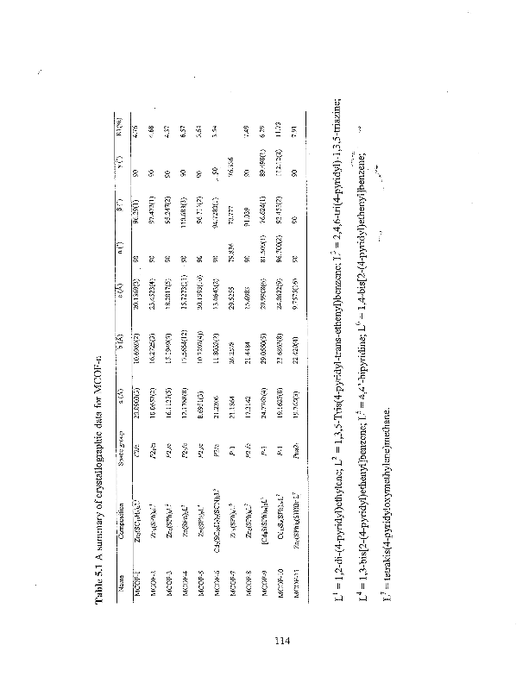
Margins remain portrait style
Landscape Style
Table
and
Caption
Page number must be portrait style

Slide 25
Format – Document Body
Pagination - 3 separate sections
  no numbers
  lowercase Roman numerals
  regular numbers
Margins
  1.5 inches top and left
  1 inch bottom and right
Widows and Orphans
  remove these
Tables, Figures ,and Captions
Double Spacing
  General rule, with some exceptions
Type Size
  10, 11 or 12 point font
Font Style
  Any legible style is fine
Use of Color is Acceptable

Slide 26
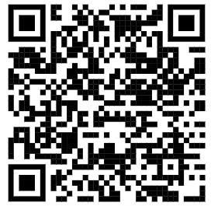
Resources for Formatting
Filing Resources page: https://graduate.ucr.edu/filing-resources
Portrait style page numbers and margins on a landscape page
Pagination
  Using section breaks or
  Combining pdf files using Adobe Pro, Preview (for Mac) or free online tools
  YouTube videos and other links available on the Filing Resources page
Templates (Word)
  Word templates are available on the Filing Resources page to be used as a general guide
LaTeX Users
  GAA does not provide support for LaTeX – there are many online support sites
  (e.g. Overleaf, Reddit, YouTube), and Grad Success can provide some support by consultation appointment via GradQuant (gradquant.ucr.edu)

Slide 27
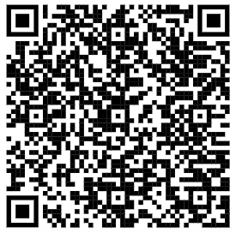
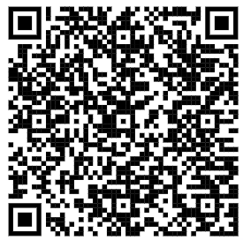
Requirements for Filing
Advanced to Candidacy
Approved Committee
Enrolled or on Filing Fee
Procedures are Different for Master’s and PhD
See Your Advancement Letter for specific information
Must be an active student to
finalize your graduation
Master’s advancement
PhD advancement

Slide 28
Filing Fee Status – what is it?
    Must be your final quarter
    Must have a completed draft and plan to take no more than 12 hours of faculty time
    Filing Fee status occurs in lieu of registration
    Filing Fee is NOT required
    Must petition Graduate Division for approval
    No enrollment in courses (consider student loans/financial aid repayment/Int’l student)
    Cost is half of the student services fee.
    It may be possible to purchase the health insurance - https://studenthealth.ucr.edu/graduates
    Student retains library privileges
    Cannot work as a TA/GSR or receive fellowship
    Can only use Filing Fee once

Slide 29
Filing in the Summer
Summer completion does not require enrollment or payment of fees UNLESS:
  There are one or more quarters of non-enrolled status during the previous academic year
  (i.e., Leave of Absence, Ready to Enroll status or Inactive Student status).
  Filing fee status counts as one quarter of enrollment.
If there have been one or more quarters of non-enrolled status, then:
  Use filing fee status (if it has not already been used)
  OR
  Enroll in 2 units of 297 (directed research) or 299 (research for the dissertation/thesis) in the
  10-week summer session
Summer Session Tuition Rates
  May be calculated by using the cost estimator tool on the Summer Sessions website
  https://summer.ucr.edu/cost-aid#estimator

Slide 30
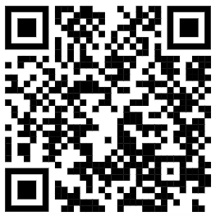
Filing Procedures
UPLOAD TO: http://www.etdadmin.com/ucr
Step 1: Format Review: must be submitted by 5pm on the deadline date.
Upload document as a pdf at the website listed above.
Complete the entire process at the ETD Admin website.
Be sure to click SUBMIT at the end of the process. This DOES NOT submit the document to the publisher, it only sends an email to GAA so that we can review the document.
Frequently Asked Questions about submission: https://graduate.ucr.edu/proquest-etd-faqs.
Order copies of your manuscript from ProQuest (optional).
  You will not be able to add or change your orders after this initial submission.
GAA will respond to your format review upload via ProQuest (by email).
  The email will explain the steps for graduation and list the format changes that must be made.
  You can wait to upload again when you have the final document prepared with format and content changes.

Slide 31
Filing Procedures
Step 2: Final Defense and Signature Approval Page
Step 2a: Surveys for PhD students only
  Must be received by GAA via R’Grad by Noon on the deadline day.
  Filing Resources page https://graduate.ucr.edu/filing-resources
  PhD students complete two surveys found here
Step 3: Upload the final version of the manuscript
  Follow the instructions given in the format review email to upload to your original ProQuest account.
  Upload must be completed by Noon on the deadline day.
    Be sure to leave yourself enough time prior to the Noon deadline in case you experience unexpected challenges.

Slide 32


Final Defense Form and Signature Approval Page
https://graduate.ucr.edu/petitions-and-forms
Final Defense Form
Form is submitted electronically via R’Grad
Signifies that you completed the final defense
The electronic form is the official version
No hard copy signatures are required
Signature Approval Page
Form is submitted electronically via R’Grad
Signifies that your committee has approved
your final manuscript
The electronic form is the official version
No hard copy signatures are required.

Slide 33
Final Defense
Required for most programs – available via R’Grad
  Final Defense PhD
  Final Defense Master’s
Check your Degree Audit to see if the defense is required
Must be completed by the final filing deadline
Signature Approval Page and the Final Defense are TWO SEPARATE requirements
  Final Defense Form signifies that you completed a final defense
  Signature Approval Page indicates that all committee members approve the final manuscript

Slide 34
Copyright Permission
Permission documents uploaded to ProQuest ETD site
  Items in your dissertation or thesis which you did not write or create
  Items copyrighted by another person or entity
Copyright and Fair Use Resources
  https://graduate.ucr.edu/copyright-and-fair-use-resources
UCR Library Research Services
  The Research Services department provides research assistance for students and faculty across the disciplines.
  951-827-3316
  https://library.ucr.edu/about/directory/research-services
  Department Hours: Monday-Friday 10am-4pm

Slide 35
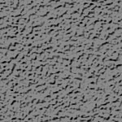
Where does my document appear?
UCR Library
  Available online and for print at PQ
  Adheres to choices made on ProQuest ETD website
  UC Institutional Repository (IR)
  Delayed release chosen in the IR Publishing Options.
  Scotty Entry
  Delayed release chosen in the PQ Publishing Options.
ProQuest
eScholarship

Slide 36
Publication considerations
Embargo Options
Creative Commons
Outside agency grants with protected data or outcomes
Experiments are ongoing
Later publication of results in a journal or as a book
Safety considerations with interviewees or other names
Later publication of results in a journal or as a book
Discuss this with your advisor
and be prepared to make informed decisions!
PrQuest

Slide 37
Graduation Deadline Dates
For a list of upcoming deadline dates visit:
  https://graduate.ucr.edu/graduation-procedures
“In Between” deadline
  Between the end of one quarter and the beginning of the next quarter.
  Timeframe is variable depending on the quarter.
  Filing during this time allows you to graduate without enrolling or paying fees for the next quarter, but the conferral date of the degree will be that next quarter.
  Format review and final deadlines are strictly enforced.
  EXAMPLE
  -Winter 2026 ends 3/20/2026 – deadline for Winter 2025 is Noon on 3/20/2026.
  -Spring 2026 begins on 3/25/2026.
  -Students who complete all requirements between 3/21/2026 and Noon on 3/24/2026 will not have to enroll or pay fees for Spring 2026 if they were enrolled or on filing fee in Winter 2026.
  -The conferral date of the degree will be Spring 2026.

Slide 38

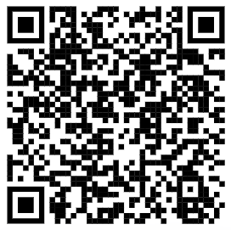
Graduation!
Transcript
The degree will be posted on your transcript by the Registrar’s Office 4-6 weeks after the conferral date.
Transcripts must be ordered; they will not be sent automatically.
Diploma
Diplomas are mailed to the permanent address 8-10 weeks after the conferral date.
Keep your permanent address up to date using your R’Web portal.
R’Web and R’Mail
You will continue to have access to these resources indefinitely.
Questions about Transcripts and Diplomas
reghelpdesk@ucr.edu
https://registrar.ucr.edu/graduation-guide/diplomas

Slide 39
THANK YOU FOR ATTENDING!
Graduate Academic Affairs
GAA@ucr.edu
Amanda
Jessica
Trina

