Slide 1
DISSERTATION/THESIS
FORMATTING & SUBMISSION WORKSHOP
Trina Elerts, Gabriela Ochoa, Amanda Wong
Graduate Academic Affairs

Slide 2
Introduction
The purpose of this workshop is to provide information about formatting the document and the steps involved in submission and graduation.
Graduate Academic Affairs, Graduate Division
    Amanda Wong (A-K), Trina Elerts (L-T), Gabriela Ochoa (U-Z)
    129, 127, 123 University Office Building, 951-827-3315
    We are working a hybrid schedule in the office/at home.
    amanda.wong@ucr.edu
    trina.elerts@ucr.edu
    gabriela.ochoa@ucr.edu
    https://graduate.ucr.edu/

Slide 3
General Resources
  GradSuccess including the Graduate Writing Resource Center – gwrc.ucr.edu
  Dissertation Writing Support - https://gwrc.ucr.edu/programs/dissertation-support/occasions
  Dissertation Support Group @ Counseling Center – counseling.ucr.edu, 951-827-5531 - Elizabeth Mondragon

Slide 4
Document Style
FIRST RULE: Format must conform to Graduate Division requirements – Format Guide
Style is at the discretion of your committee
  May choose to use MLA or APA or another style manual as a guide, but be careful, these guides do not match the Graduate Division requirements exactly.
Journal format or scientific format
  Each chapter is a separate paper
  Must have a general introduction and conclusion
  Be consistent! Must use the same style for each chapter (including abstract, bibliography and footnotes/endnotes)

Slide 5
Format - Preliminary Pages
Title Page (page i, not printed)
Copyright Page (page ii, not printed)
Signature Approval Page (page iii, not printed)
Acknowledgements (optional)
Dedication (optional)
Abstract (required for PhD only)
Table of Contents (required)
List of Figures, Tables, Abbreviations, Symbols, etc… (required, if necessary)
Preface or Forward (optional)

Slide 6
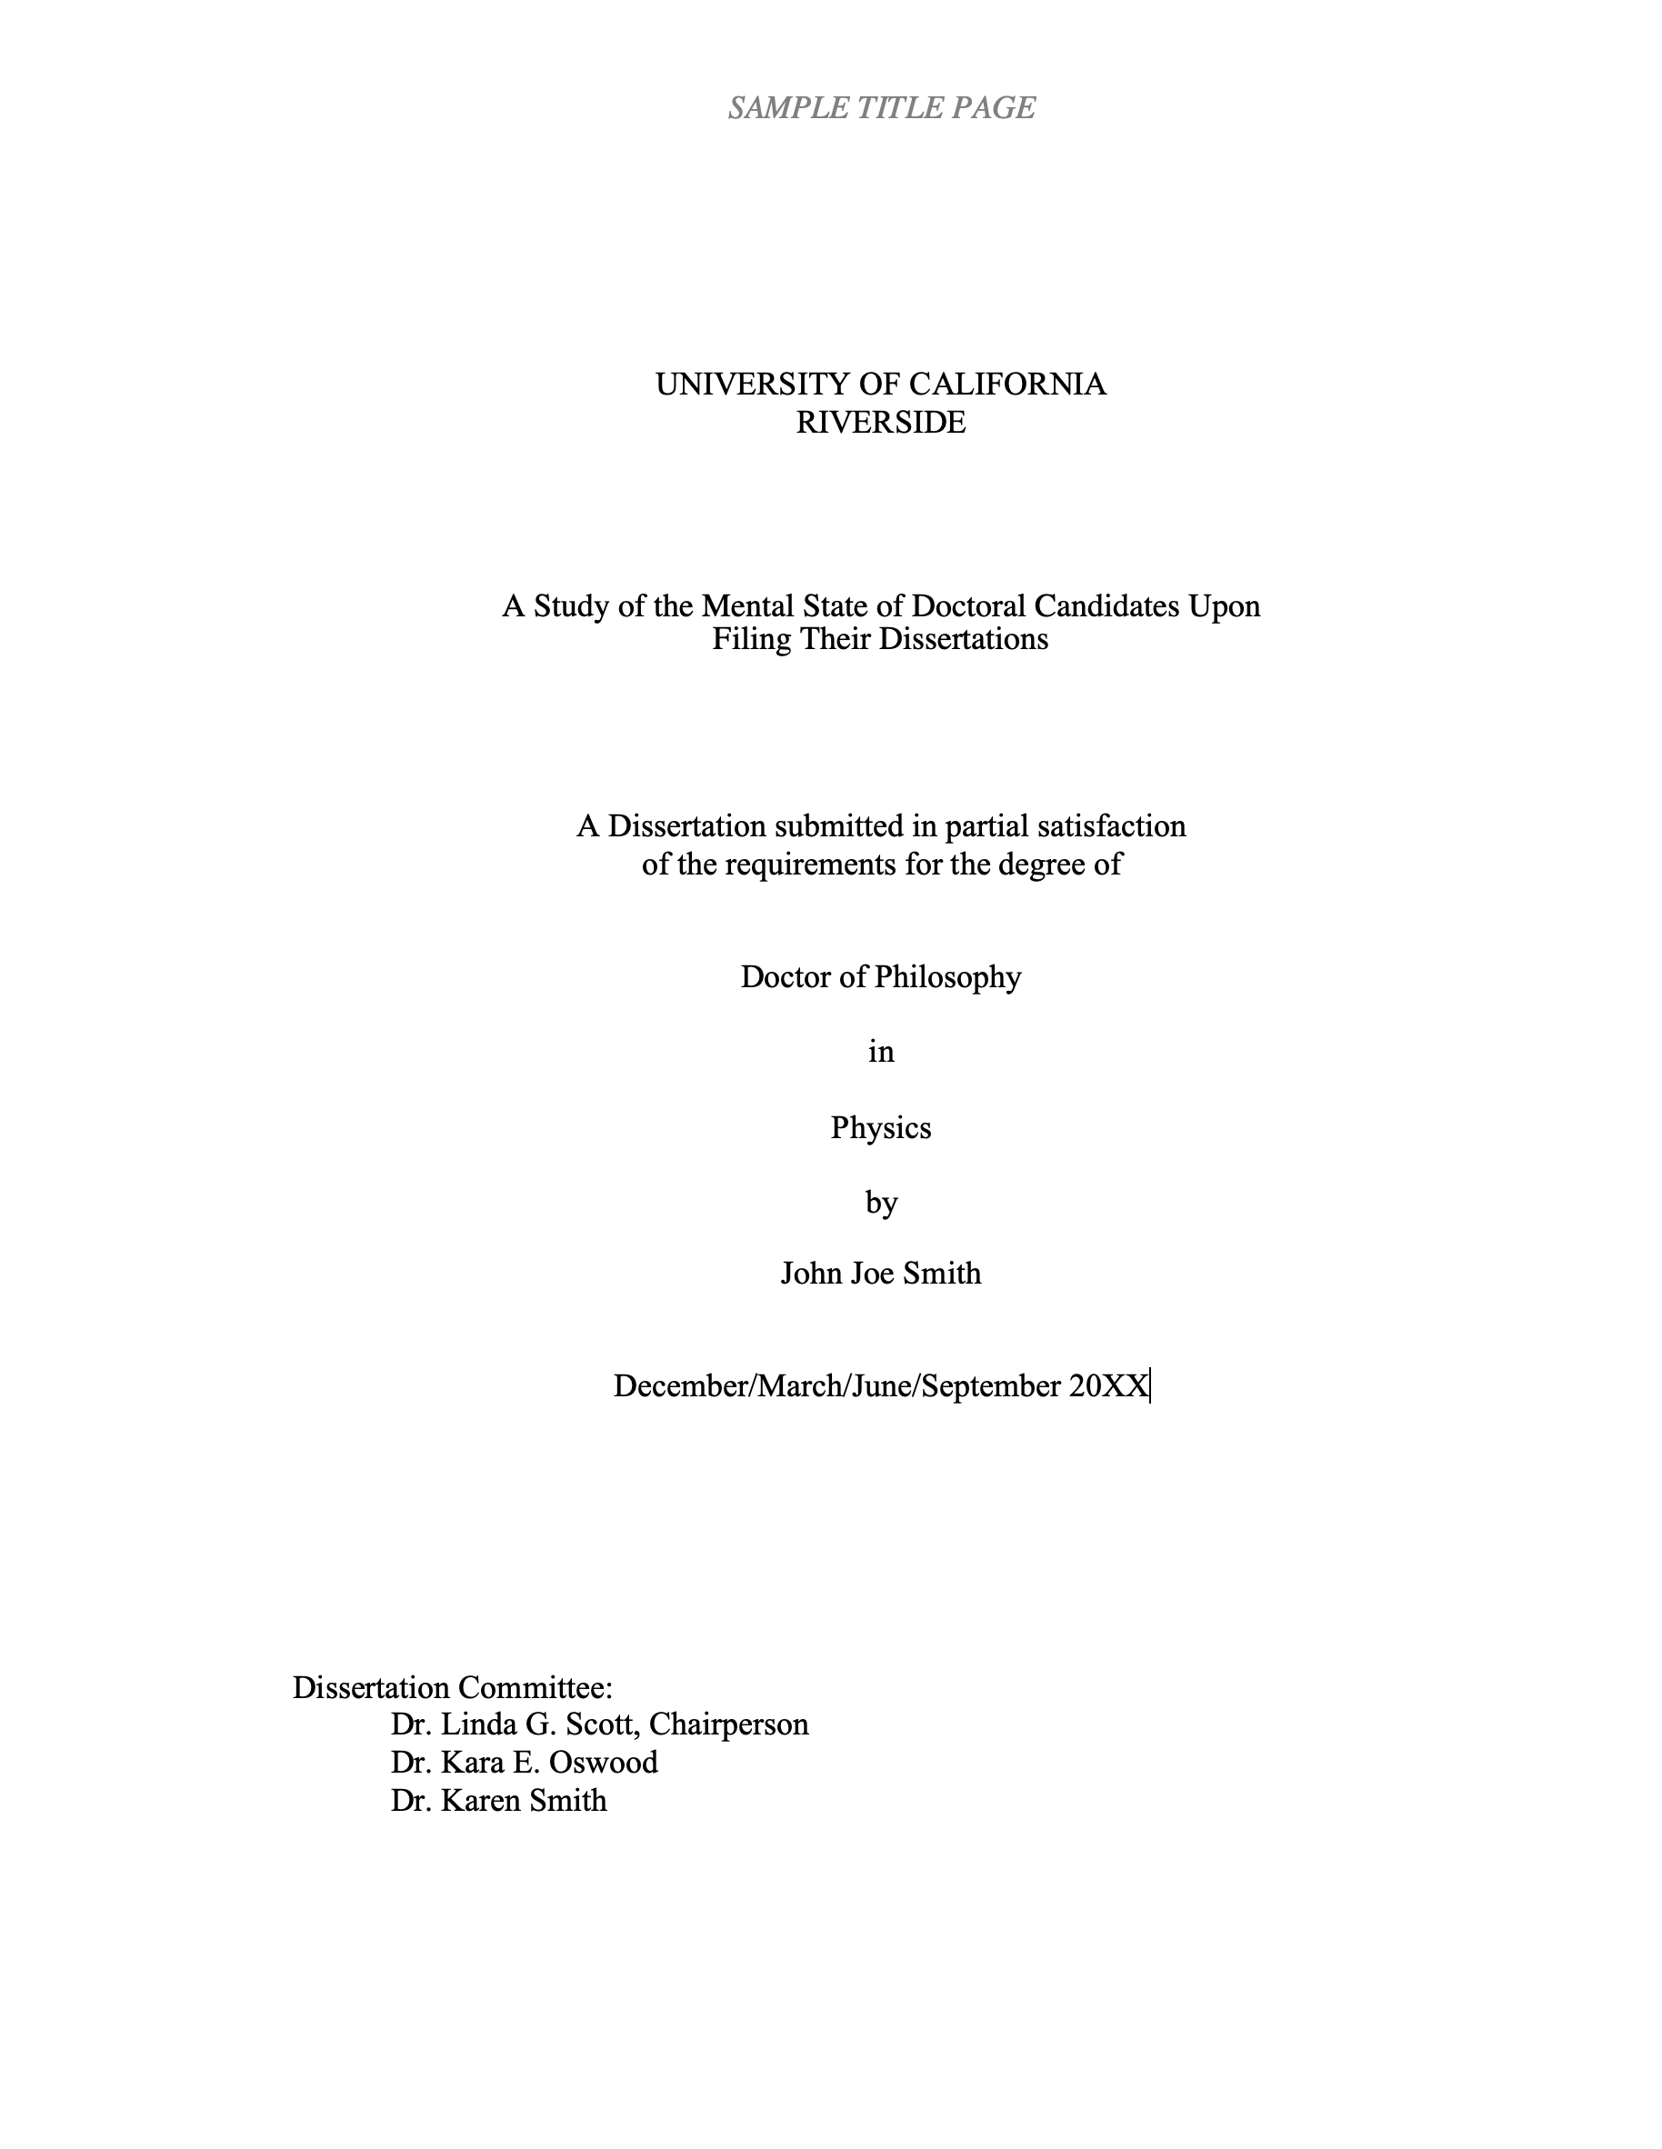

Slide 7


Slide 8
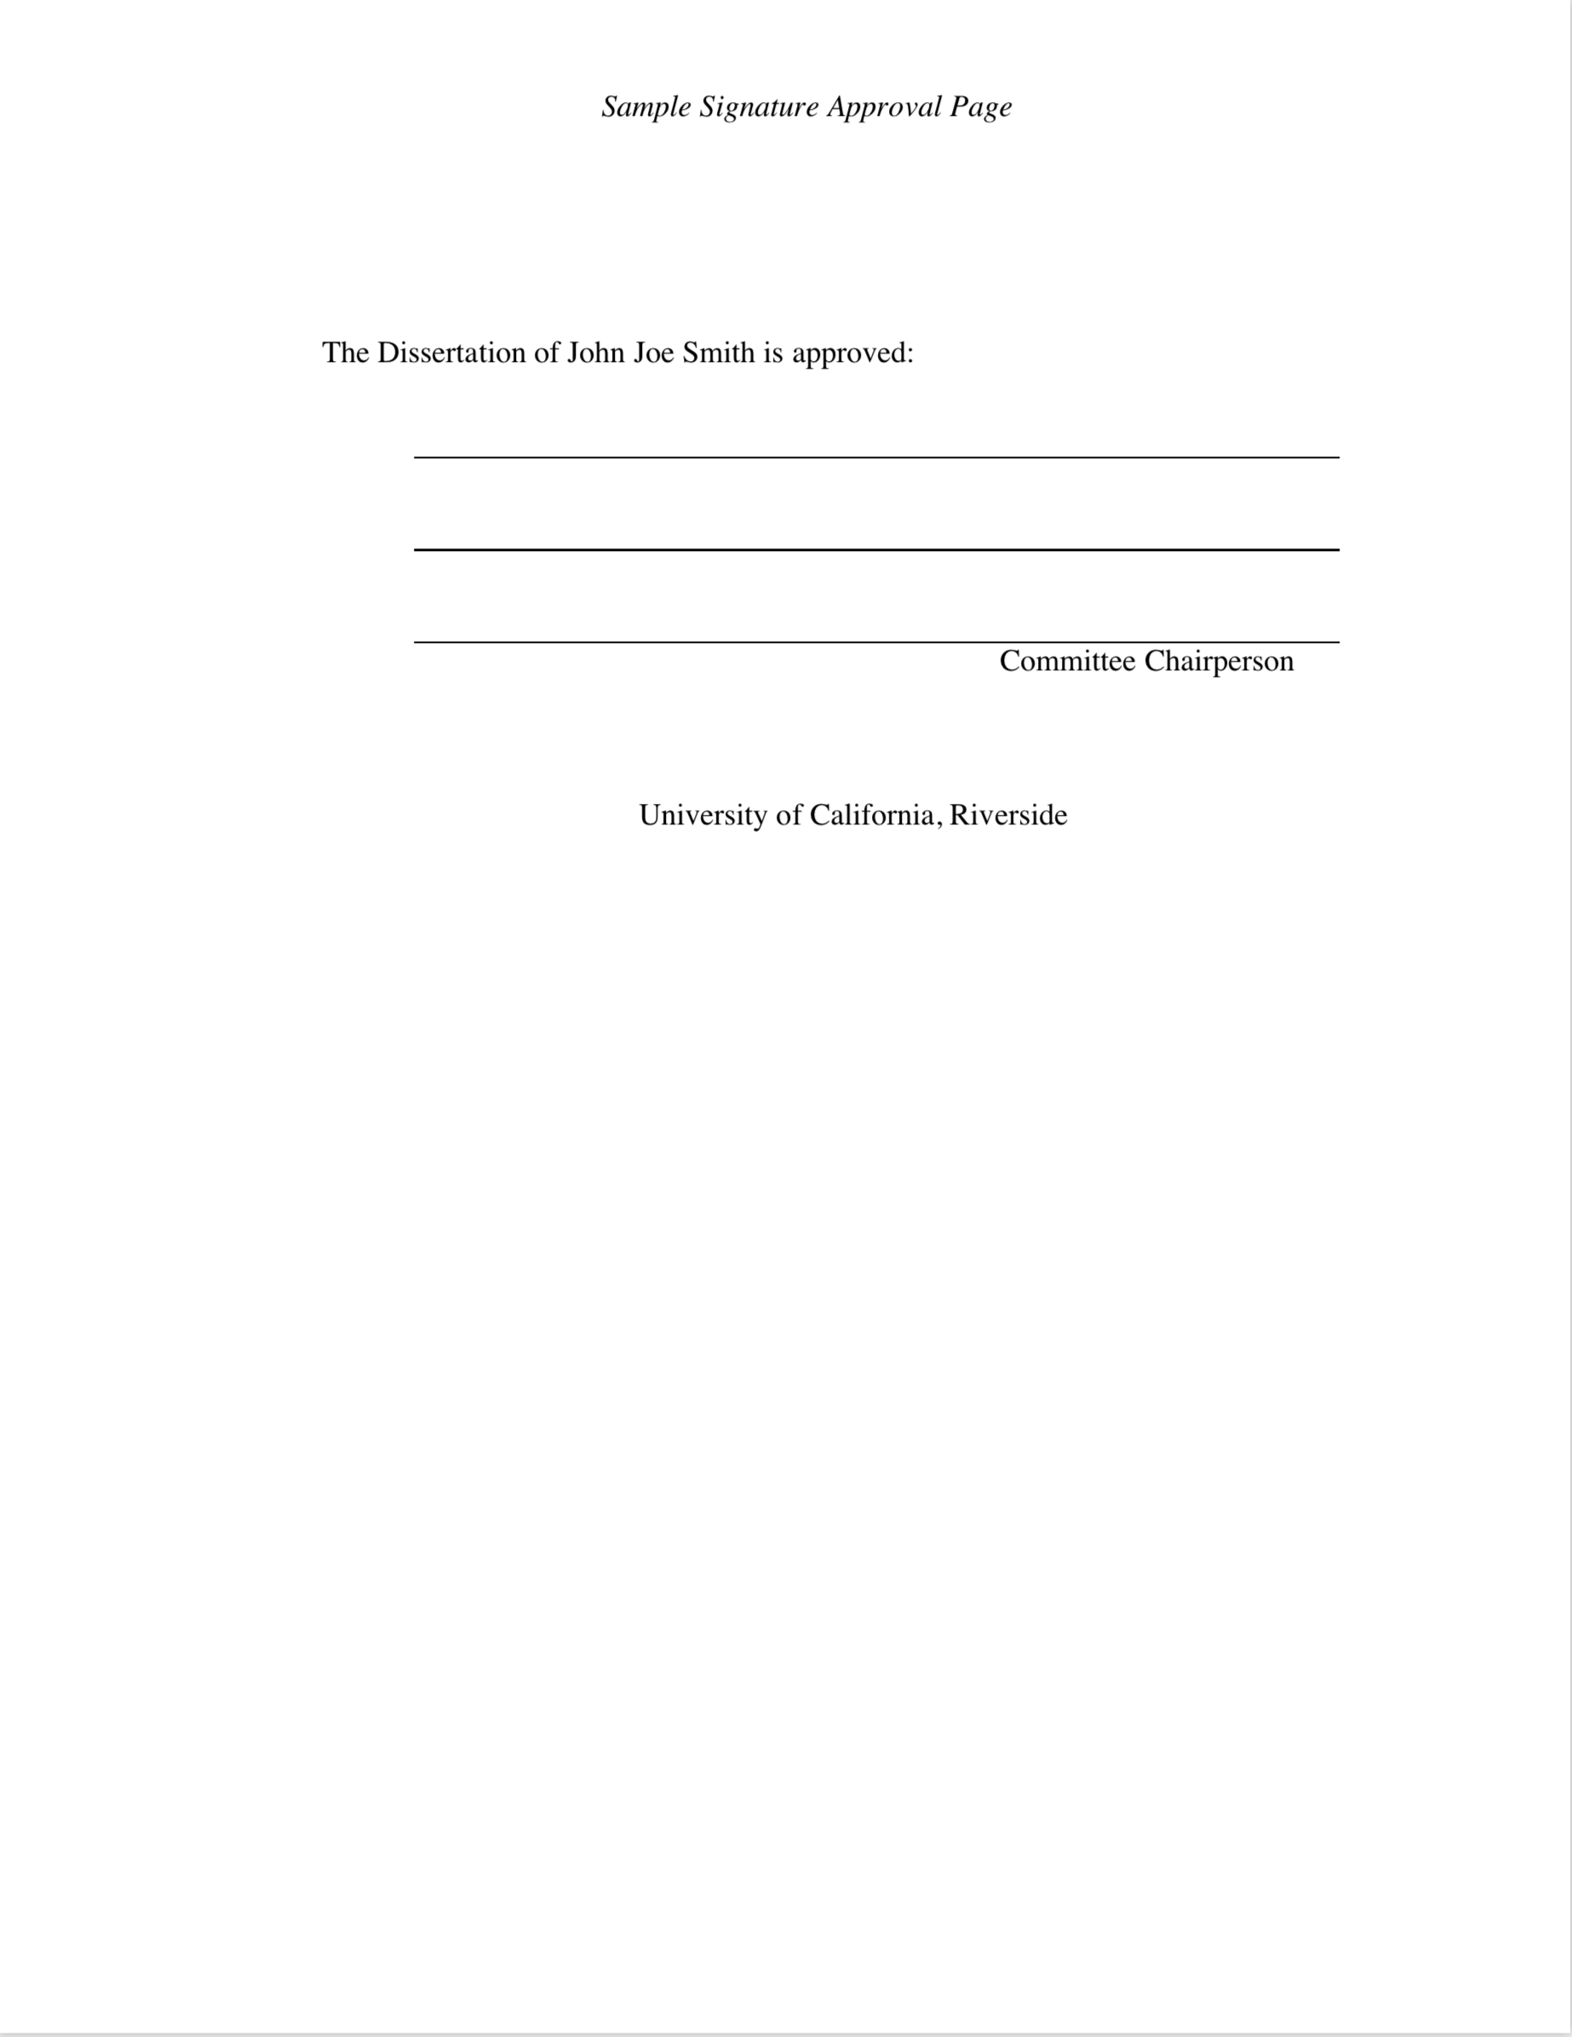

Slide 9
Format - Preliminary Pages
Title Page (page i, not printed)
Copyright Page (page ii, not printed)
Signature Approval Page (page iii, not printed)
Acknowledgements (optional)
Dedication (optional)
Abstract (required for PhD only)
Table of Contents (required)
List of Figures, Tables, Abbreviations, Symbols, etc… (required, if necessary)
Preface or Forward (optional)

Slide 10
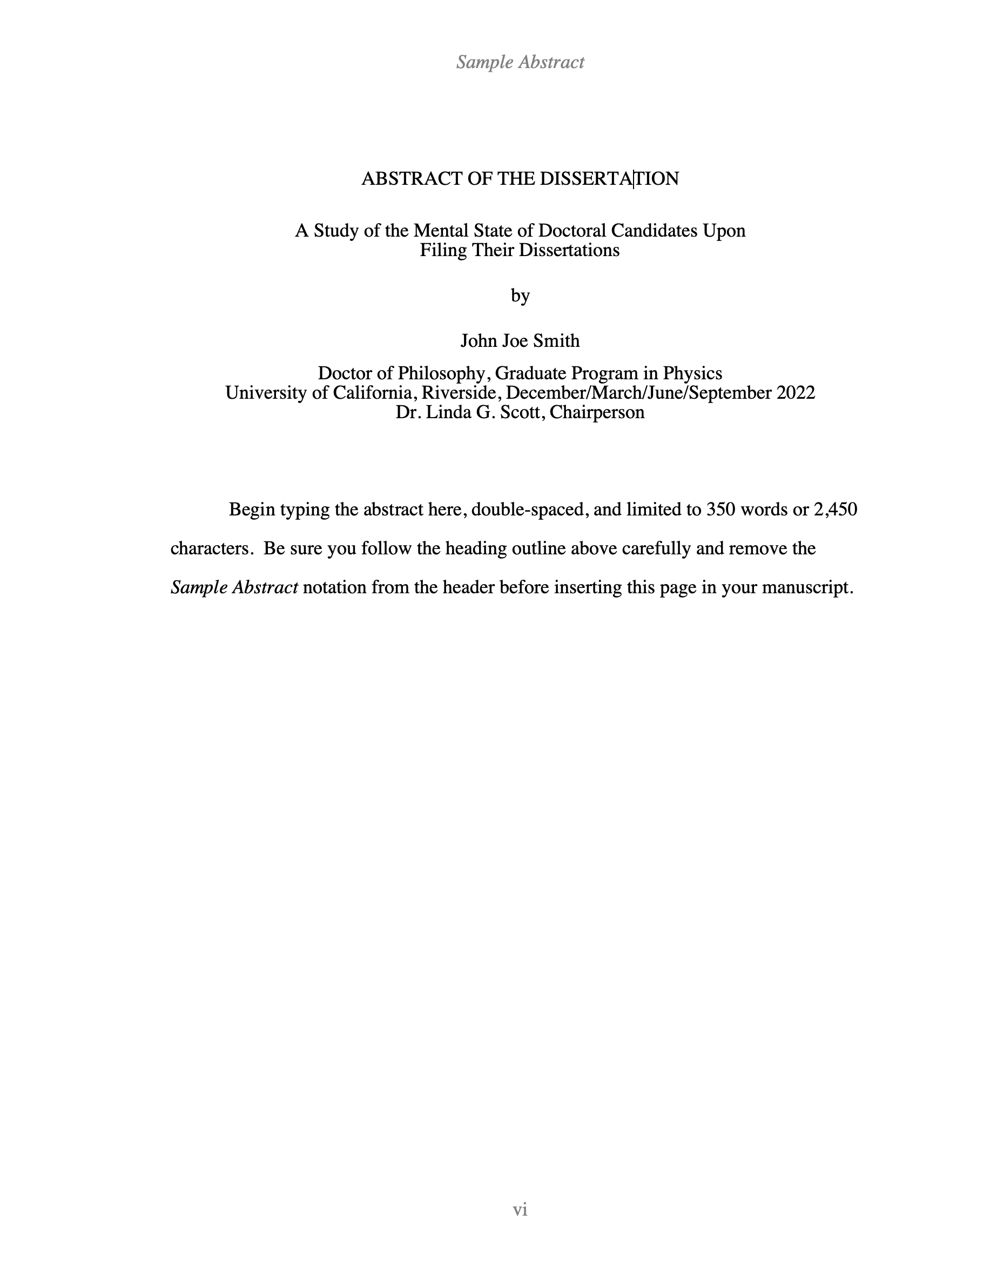

Slide 11
Format - Preliminary Pages
Title Page (page i, not printed)
Copyright Page (page ii, not printed)
Signature Approval Page (page iii, not printed)
Acknowledgements (optional)
Dedication (optional)
Abstract (required for PhD only)
Table of Contents (required)
List of Figures, Tables, Abbreviations, Symbols, etc… (required, if necessary)
Preface or Forward (optional)

Slide 12
Format - Document Body
Pagination – 3 separate sections (no numbers, lowercase roman numerals, and regular numbers)
Margins - 1.5” on left & top, 1” on right & bottom
Widows and Orphans – remove these
Tables, Figures and Captions - examples
Double-spacing - general rule, some exceptions
Type Size - 10, 11 or 12 point
Font Style – any legible style is OK
Use of color is acceptable

Slide 13
Widow Line

Slide 14
Orphan Heading

Slide 15
Format - Document Body
Pagination – 3 separate sections (no numbers, lowercase roman numerals, and regular numbers)
Margins - 1.5” on left & top, 1” on right & bottom
Widows and Orphans – remove these
Tables, Figures and Captions - examples
Double-spacing - general rule, some exceptions
Type Size - 10, 11 or 12 point
Font Style – any legible style is OK
Use of color is acceptable

Slide 16
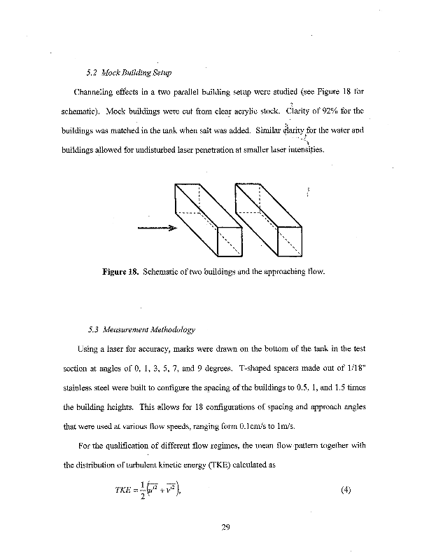
Figure & Caption embedded in text

Slide 17
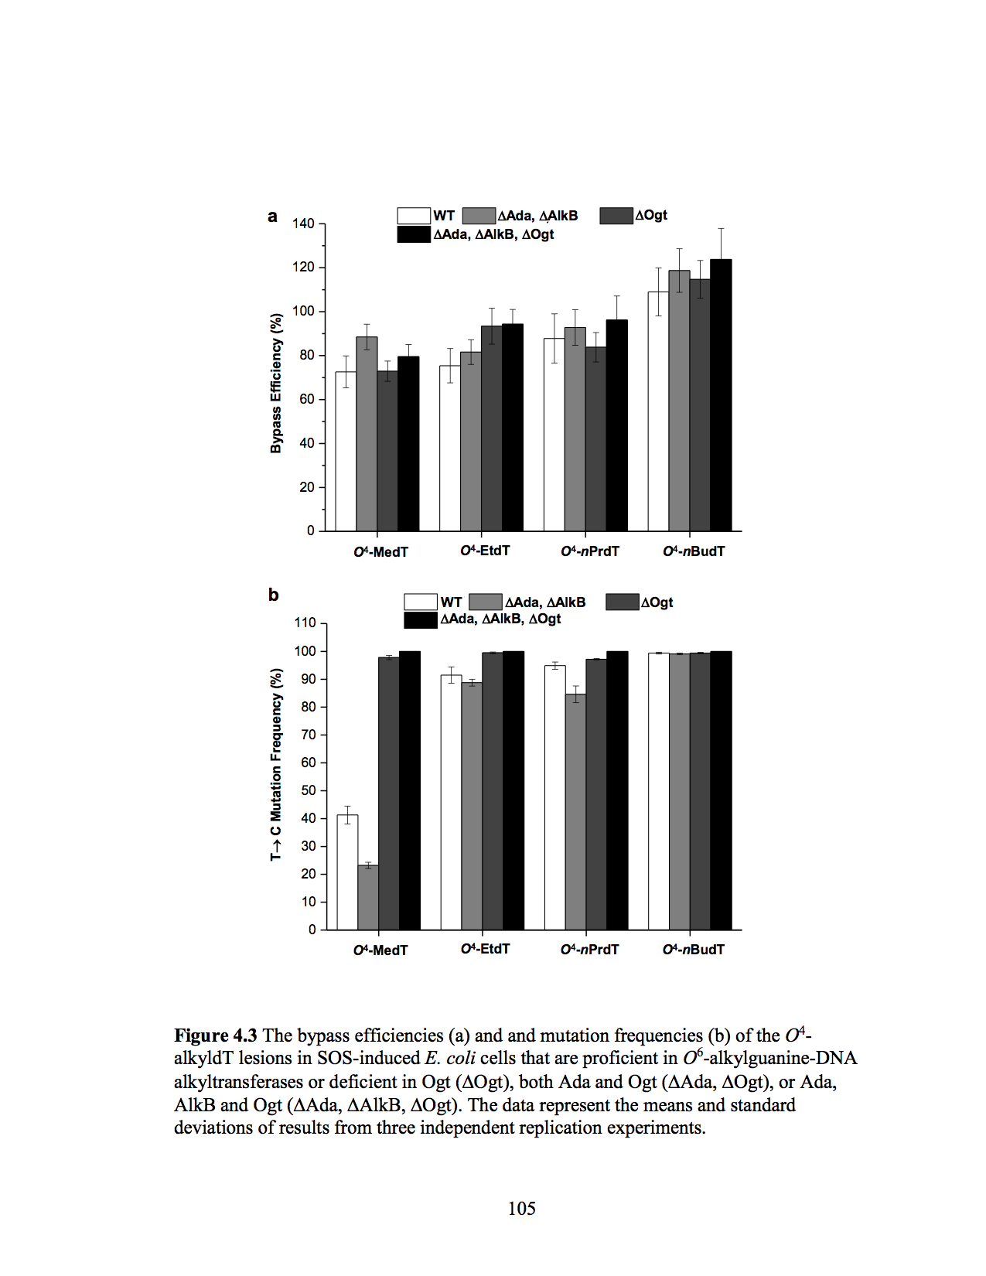
Figure & Caption on own page

Slide 18

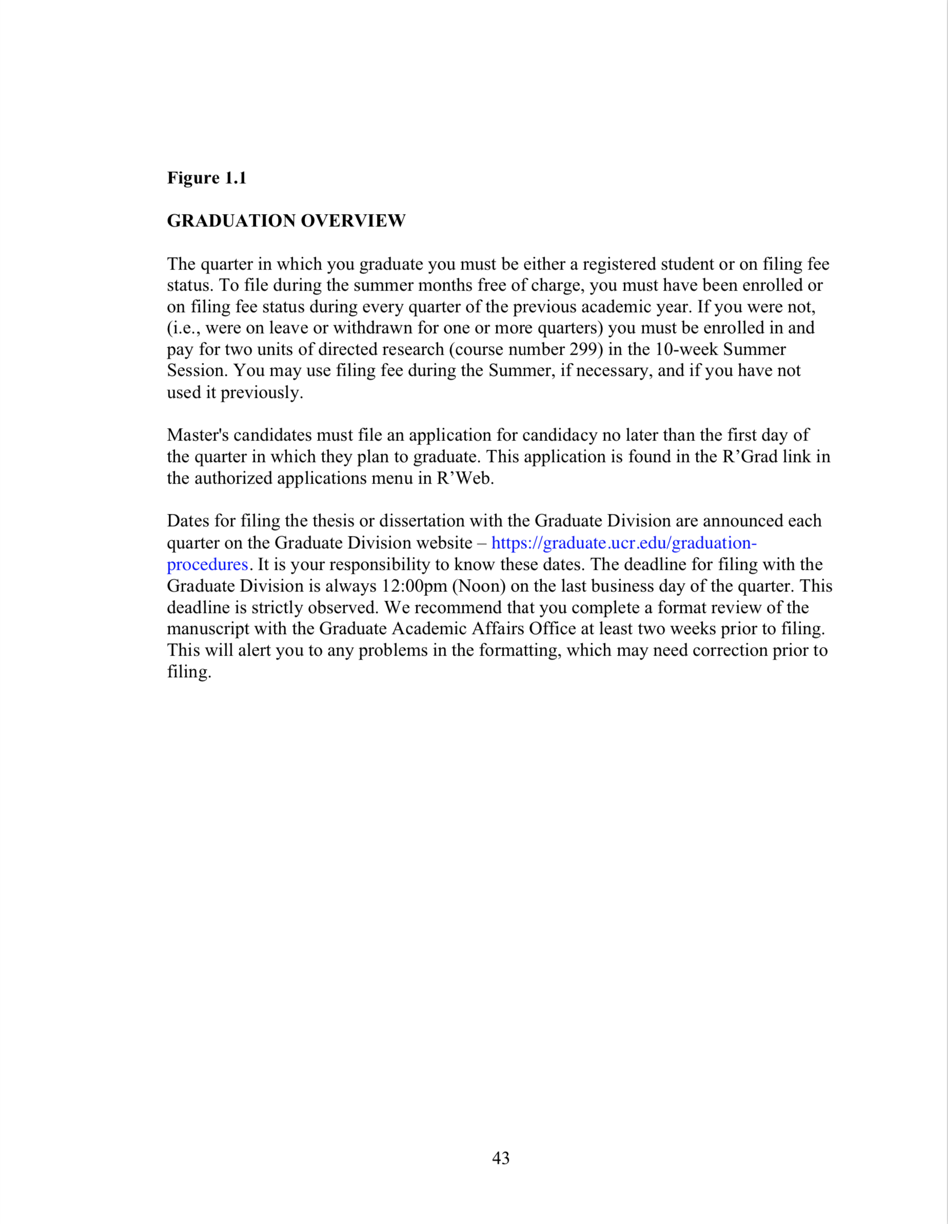
Caption and Figure on Separate Pages
Figure
Caption

Slide 19
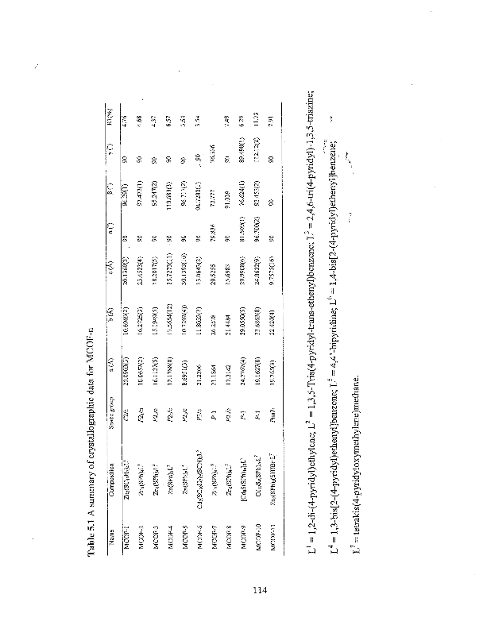
Landscape Table & Caption
Page number must be portrait style

Slide 20
Format - Document Body
Pagination – 3 separate sections (no numbers, lowercase roman numerals, and regular numbers)
Margins - 1.5” on left & top, 1” on right & bottom
Widows and Orphans – remove these
Tables, Figures and Captions - examples
Double-spacing - general rule, some exceptions
Type Size - 10, 11 or 12 point
Font Style – any legible style is OK
Use of color is acceptable

Slide 21
Resources for Formatting
Instructions for these items available on the Graduate Division filing resources page. https://graduate.ucr.edu/filing-resources
Portrait style page numbers on a landscape page.
Pagination
  Using section breaks, or
  Combining pdf files (recommended) – Use Adobe Pro, Preview (Mac) or free online tools. Youtube videos and other links available on the filing resources page.
Templates (Word)
  Word templates and a page number/margin guide are available on the filing resources page.
LaTex Users
  Templates are available at https://graduate.ucr.edu/filing-resources.

Slide 22
Requirements for Filing
Must be Advanced to Candidacy
    Procedures different for PhD and master’s
Approved Dissertation or Thesis Committee
Must be enrolled & paid or on Filing Fee Status. Summer filing?
    Filing Fee status occurs in lieu of registration
    Filing Fee is NOT required
    Must petition Graduate Division for approval
    No enrollment in courses (consider student loan/financial aid repayment/Int’l student)
    Must have a completed draft and plan to take no more than 12 hours of faculty time
    Cost is half of the student services fee. You can opt to purchase the health insurance. Contact the Health Center for information.
    Student retains library privileges
    Cannot work as a TA/GSR or receive fellowship
    Can only use Filing Fee once
Notes:
Spring – March 1st
^{Summer – June 1st}

Slide 23
Filing Procedures
UPLOAD TO: http://www.etdadmin.com/ucr
Step 1: Format Review – Must be completed at least two weeks prior to final filing deadline.
  Upload document as a pdf at the website listed above. It does not have to be the final version.
  Complete the entire process at the ETD Admin website. Once all the boxes on the left side of the screen are checked, you can “submit” via the bottom link. The document will not be forwarded to the publisher at this point. If you are having trouble, review the help screens or the Graduate Division FAQs - https://graduate.ucr.edu/proquest-etd-faqs.
  You will not have the opportunity to change your publishing and bound copy choices after this initial submission. You will be able to upload a final version of the document.
  We will respond via email through ProQuest. The email will explain the steps for graduation and list the changes that need to be made to the document.

Slide 24
Filing Procedures
UPLOAD TO: http://www.etdadmin.com/ucr
Step 2: Confirmation that both your final defense (if required) and your written dissertation have been approved, along with any additional paperwork must be received by Graduate Academic Affairs by 12:00pm on the deadline day. A list of the additional paperwork is available at https://graduate.ucr.edu/filing-resources. The signature page in the pdf version must be blank, no signatures.
Step 3: Upload the final version of the document to the ETDadmin website and SUBMIT. If you are submitting on the final day, make sure you leave yourself enough time prior to the 12:00pm deadline in the event you experience unexpected challenges.

Slide 25
Procedures for Final Defense Form and Signature Approval Page
FINAL DEFENSE
The final defense form (Form 5) is submitted electronically. You can find the link to the form on our website here: https://graduate.ucr.edu/petitions-and-forms.
A hardcopy Form 5 with wet signatures is not required.
SIGNATURE APPROVAL PAGE
The signature approval page is submitted electronically. You can find the link to the form on our website here: https://graduate.ucr.edu/petitions-and-forms.
A hardcopy signature approval page with wet signatures is not required.

Slide 26
Final Defense
Required for most programs.
PhD Students required form:
    “Form 5” - Report of Final Defense.
Master’s Students required form:
    Report of Final Defense.
The final defense must be completed by the final filing deadline.
Signature Page for the document and Final Defense form are two separate requirements (2 separate forms).

Slide 27
Acknowledgement of Previously Published Materials vs. Copyright Permission
Acknowledgement of Previously Published Materials
  Articles authored by you that have been accepted for publication or previously published at the time of filing, must submit the acknowledgement petition
  This petition is used to verify your advisor knows and agrees to what will be included in your document.
  You are not required to submit permission from the journal to the Graduate Division.
Copyright Permission (in ProQuest ETD site)
  Permission you have received from the copyright holder to include their work in your document.
Visit https://graduate.ucr.edu/copyright-and-fair-use-resources for additional resources and information.

Slide 28
Where Does the Document Go?
ProQuest
Available online and for print at PQ
UCR Library
Scotty Entry
eScholarship
Delayed release chosen in the IR Publishing Options.
Adheres to choices made on ProQuest ETD website
UC Institutional Repository (IR)
Delayed release chosen in the PQ Publishing Options.

Slide 29
ProQuest ETD Website FAQs
https://graduate.ucr.edu/proquest-etd-faqs
ETD stands for “Electronic Theses and Dissertations”
Publishing Options – Traditional (free) vs. Open Access ($), your choice to make
Delayed Release – you decide the time period, if any. Requests between 3 and 5 years, put a “note to administrator”. All requests over 2 years are reviewed on a case-by-case basis.
IR Publishing Options – Delay here should match PQ delayed release
University Agreement – info regarding what happens to your document after submission
Creative Commons (optional) – you decide whether or not to apply a Creative Commons License to the Library and eScholarship copy of your document. This is useful for authors who want to make it easy for their work to be shared and built upon.
Copyright Permissions – for work in the document that you don’t hold copyright for
Administrative Documents – upload the Acknowledgement of Previous Published Material, for your previously published work. This form can also be submitted hard copy.
Additional Copyright (optional) – registering with the Library of Congress ($)
Ordering Bound Copies from ProQuest (optional) – you can order bound copies from anywhere. The “free library” copy listed on this page will not be sent to you. ($)
SUBMIT – you must complete this step each time the pdf is updated. Submitting WILL NOT send your document to ProQuest, only to Graduate Academic Affairs.
After making your initial choices, you will not be able to change publishing options or copy orders. You will be able to upload a new pdf. Changes to the other options can be made only by withdrawing the entire submission and beginning again.

Slide 30
Graduation Deadline Dates
For a list of upcoming deadline dates: https://graduate.ucr.edu/graduation-procedures
“In Between Deadlines”
  There is a period after one quarter ends and the next begins.
  This amount of time varies depending on the quarter.
  For example, if the Summer quarter ends September 10, all students wishing to receive a Summer graduation date must complete the requirements on or before that date. However, Fall quarter doesn't begin until September 19th, so students have until the last business day before the next quarter begins, to complete the requirements and avoid fees for the next quarter. The conferral date for the degree would be for the next quarter (Fall in this example).
*tentative date

Slide 31
Graduation!!!
The degree will be posted on your transcript, by the Registrar’s office, 1 month after the conferral date. You must order a transcript, it will not be sent automatically.
The Diploma will be available approximately 2 months after the conferral date. It will be mailed to your permanent address by the Registrar’s office.
You will always have access to R’Web and R’Mail.

